Slide 1


Preparing For Your
DPS Journey
Part II
DPS Academic team
November 2023
Peter Do SS19

Slide 2
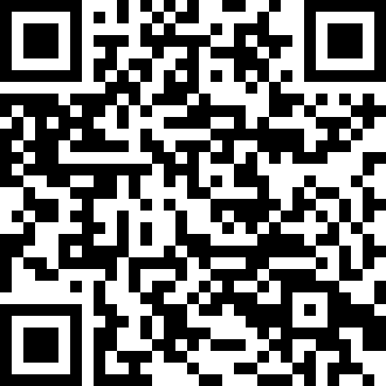
REGISTER
Please scan the QR code to add your name to the register on Moodle.
If it doesn’t work please sign manual register by door.
Thanks!
Notes:
To avoid overloading the slides with text, use speaker notes to add more detail and prompts.

Slide 3
Participants consent to collect activity mind maps
Conducting Academic Teaching Research.
Your participation in two of our activities in this session gives consent for the information collected from the activity to be used as part of a research study.
The research study is about the DPS programme, students experience, aspirations and expectations and the data from this session will be used for this study.
Only tutors on the teaching programme will have access to data collected from the activity.

Slide 4
Participant consent to collect activity mind maps
If you give consent for your mind maps to be used, please hand it in after the session. (take a pic if you want to remember what you wrote!)
Please do not add your name to the mind map activities sheets.
If you do not give consent please keep hold of your activity sheet.
If after the session you wish to withdraw your consent and do not want your mind map included in study please email me.

Slide 5
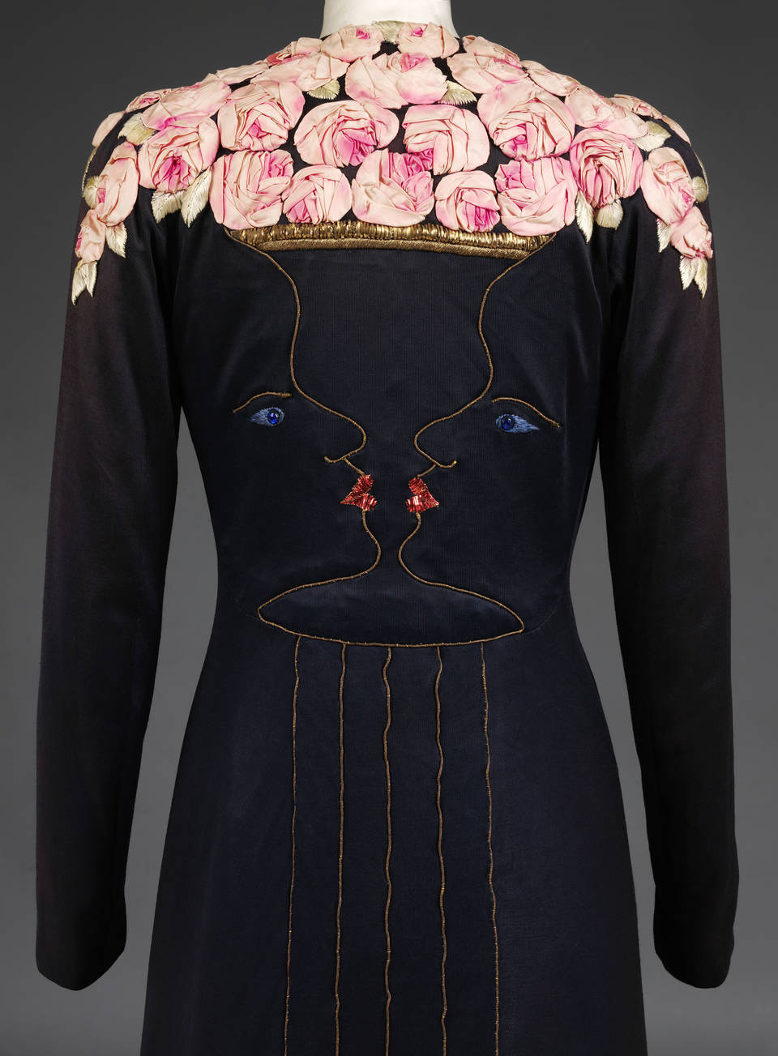
Today’s Session:
Preparing for your placement year:
Your online profile
Mind Map Activity: Brands and Businesses
Creating your own contact list.
Speculative emails –(Opt-in requirement)
Job searching strategies
Portfolio’s
Career support and online resources.
Dior @ V&A
SCHIAPARELLI at the V&A

Slide 6
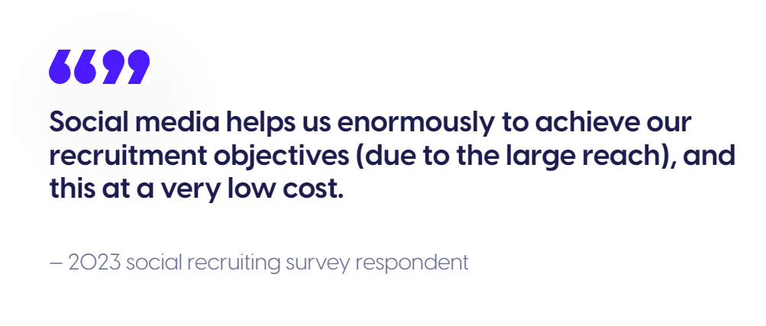
Your online profile:
98% of recruitment, talent acquisition and employer branding teams used social media in 2023
Dior @ V&A
https://www.contentstadium.com/blog/social-recruiting-statistics/

Slide 7
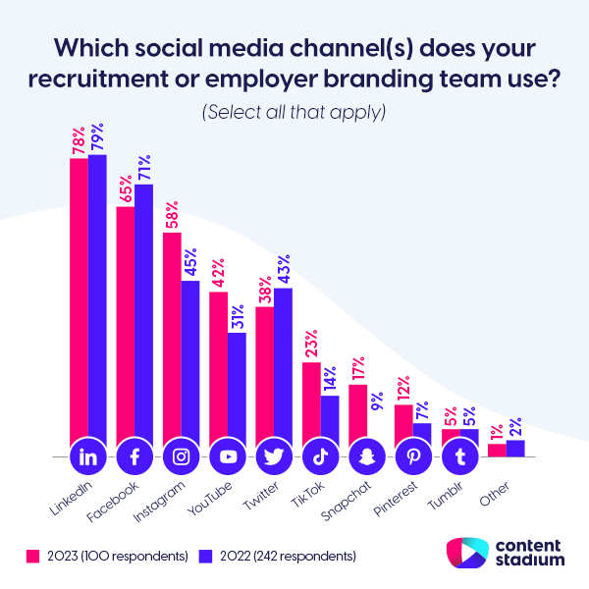
Your online profile:
Some surveys show around 70% of employers glance at applicants’ profiles before considering them for a role. Clearly, social media screening is no longer a taboo and is becoming a standard part of the screening process for new hires
Your digital footprint provides a glimpse into your character, values, and professional profile.
Source: https://veroscreening.com/social-media-screening 2022
Dior @ V&A

Slide 8
Your online profile:
What can you do to ensure you don’t lose out on a job because of your social media activity?
Think about the impression you want to create. Your personal brand. Your platform should showcase your talents positively.
What kind of social media activity is considered ‘adverse’?
There are a number of factors that are generally seen as concerning in the recruitment process.
Information which contests the information on your CV
Derogatory posts written about a former employer
Inappropriate language
Illegal or offensive behaviour
Dior @ V&A

Slide 9




Your online profile: Keep it clean!
It is important to review your social media footprint. When screening your own profiles, be thorough. Consider anything that you wouldn’t be comfortable saying to a potential employer, or that could be considered offensive.
Where possible you should remove any activity which could be contentious, where it can't be removed be ready to explain the background and context if it does come up.
Review your privacy settings - make sure you know exactly what’s visible to the public and consider this in any future activity.
​Moving forward, always think before you post. Think longer term than the newsfeed and wider than your following – your social posts could be seen long after they are published and could harm your chances of securing a job. https://www.reed.com/articles/what-is-social-media-screening
Dior @ V&A

Slide 10
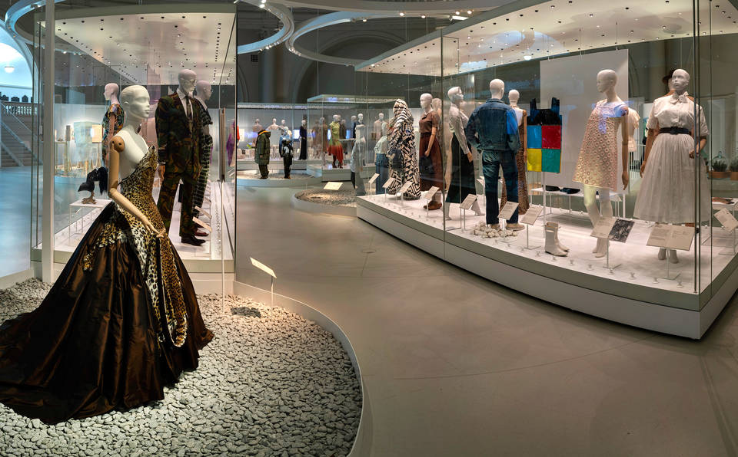
Fashion &Nature exhibition V&A
Dior @ V&A

Slide 11

Activity: Global Brands & Businesses
Create a mind map:
In 2 minutes list as many Non European or US brands, businesses, creatives.
Think emergent markets such as South America, Asia Pacific region, Africa,
The Middle east…. Do not use Google!
Non-Euro & US brands & businesses
Map of Asia-Pacific region
Dior @ V&A

Slide 12
Activity: My brands & Businesses
Create your own mind map:
In 2 minutes list as many brands, businesses or creatives you would like to work with during your placement year.
Write on the map where they are located geographically.
My ideal placement brands & businesses & Where
Dior @ V&A

Slide 13

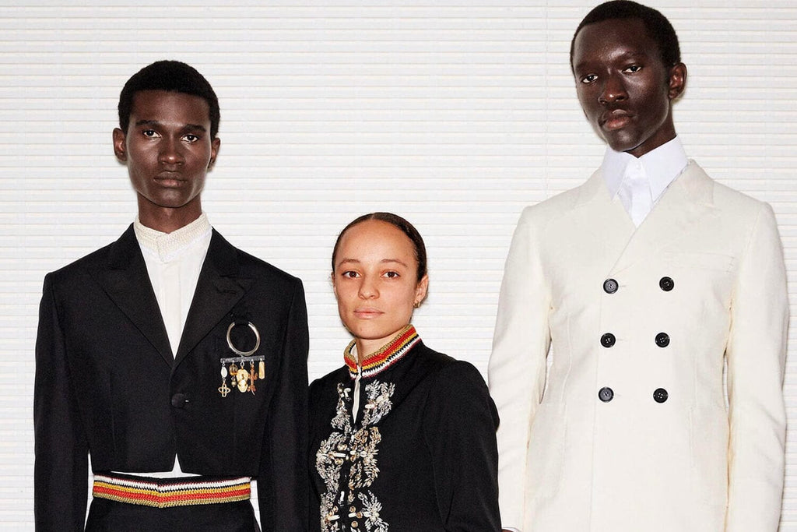
Creating your own contact list:
Over the Christmas break start to research and build your wish list of brands, businesses or creatives you would like to work for during your placement year. This list should be extensive
(at least 20) Do your research. Be open. Think broadly: Market level, size of business, locations etc.
Uma Wang
Grace Wales Bonner

Slide 14

Creating your own contact list:
Which brands or businesses align with your skills, interests and values?
Who do you identify with as a creative?
What skills & experience do you want to develop over the year?
What do you mostly want to achieve this year?
Uma Wang
Amisha Kapadia stylist: MMG artists London

Slide 15
Creating your own contact list :
Use LinkedIn as a means to finding relevant members of the team you can connect with.
Follow designers, stylists or photographers on social media.
Go to website of brands, find contact email.
Find creative agencies for photographers/stylists and creative directors to work with.
Ask pathway tutors and final year students for contacts.

Slide 16
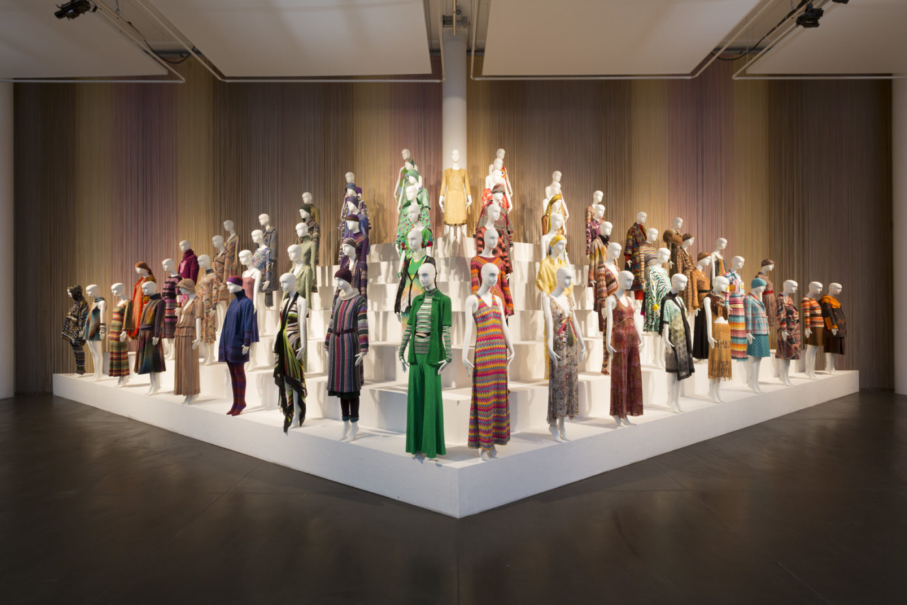
Missoni @ Fashion & Textile museum

Slide 17
Preparing for your DPS journey : Speculative Emails
What is a speculative email ?
A speculative email is sent alongside your CV when you apply to a company that isn’t currently advertising a role.
Some companies/ brands do not advertise. Be proactive and approach companies. Many students find internships this way!
Rather than being written with a particular position in mind (As with a cover letter), they’re usually more tailored to the company – selling your skills and experience should any potential vacancies arise.

Slide 18
Preparing for your DPS journey : Speculative Emails
Draft a speculative email template ready to use when the time comes. Have it proof read!
Aim to start sending out your speculative emails in February/March, this is because businesses can take their time to respond.
Find the correct contact to address and send your email to. Use everything at your disposal. LinkedIn, Instagram, brand/company website, professional/friends contacts.
We will share a list of contacts who are happy to receive speculative job emails, however this list is not extensive and made up of brands and companies that may not be your preference. This is why you must develop your own list.

Slide 19
Preparing for your DPS journey : Speculative Emails
Speculative emails
Create a list of companies you would like to work for
Use company website, LinkedIn, or Social media to find the relevant contact details for your email.
Create a speculative email template
Research each company and tailor your email
(1/2 paragraphs)
Send your email.
Track dates sent and be prepared to follow up

Slide 20
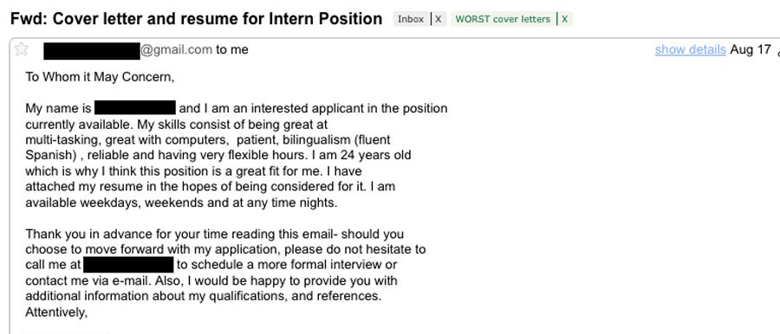
Preparing for your DPS journey : Speculative Emails
Before we review the recommended structure and content for Speculative email lets have a look at some examples from the internet……. Have a quick skim read, and share what do you think about these emails.

Slide 21
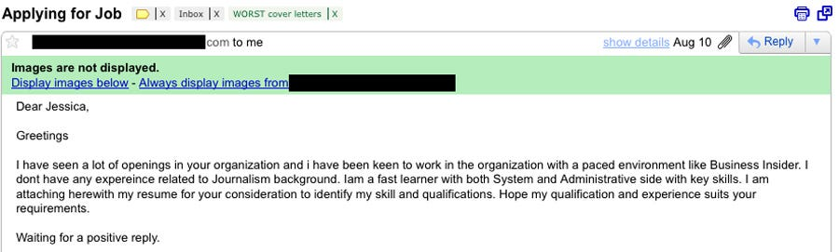
Preparing for your DPS journey : Speculative Emails

Slide 22
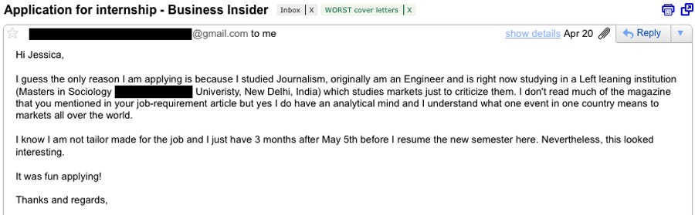
Preparing for your DPS journey : Speculative Emails

Slide 23
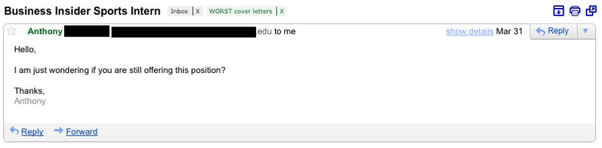
Preparing for your DPS journey : Speculative Emails
https://www.businessinsider.com/

Slide 24
Preparing for your DPS journey : Speculative Emails
Recommended structure:
Address your email to someone specific. Try not to address it to a generic Sir/Madam or “To whom it may concern”.
Dear Kathy
I hope this email finds you well.
Introduction
Tell them who you are and what you are looking for.
My name is Wande and I’m a 2nd year student at Central Saint Martins studying BA(Hons) Fashion design Womenswear. As part of my studies, I will complete a placement year starting in September 2024 and ending in June 2025.
Outline what kind of role you’re looking for: Design/Marketing placement, you can mention preferred duration
i.e. I am ideally looking for a placement that is a minimum of 3 months in duration.

Slide 25
Preparing for your DPS journey : Speculative Emails
1st Paragraph
Research the company or brand thoroughly. Reference anything specific that you like, admire or that is occurring within the brand. why do you want to work for them? Be complementary!
The 1st paragraph is the interchangeable section of your email. Everything in your email stays the same except for this section that is specifically about the brand/business.
2nd Paragraph
Explain a bit more about who you are (think interests, values etc,) your own skills, experience and background. Be positive. Evidence your skills and experience. However, don’t be afraid to say that you’re looking to learn and further develop your skills.

Slide 26
Preparing for your DPS journey : Speculative Emails
3rd Paragraph
A closing paragraph to sum up why you’d be a great fit for the brand/business, and why they would benefit from hiring you. Be specific, maybe reference a new brand undertaking.
Mention your availability for an interview, tell them you have a requirement to confirm your first placement by the end of July 2024.
Thank them for their time, and a professional sign-off (e.g. Kind regards, sincerely, I look forward to hearing from you)
Add your CV and link to portfolio (if relevant) You can say that you are happy to send your portfolio at their request.

Slide 27
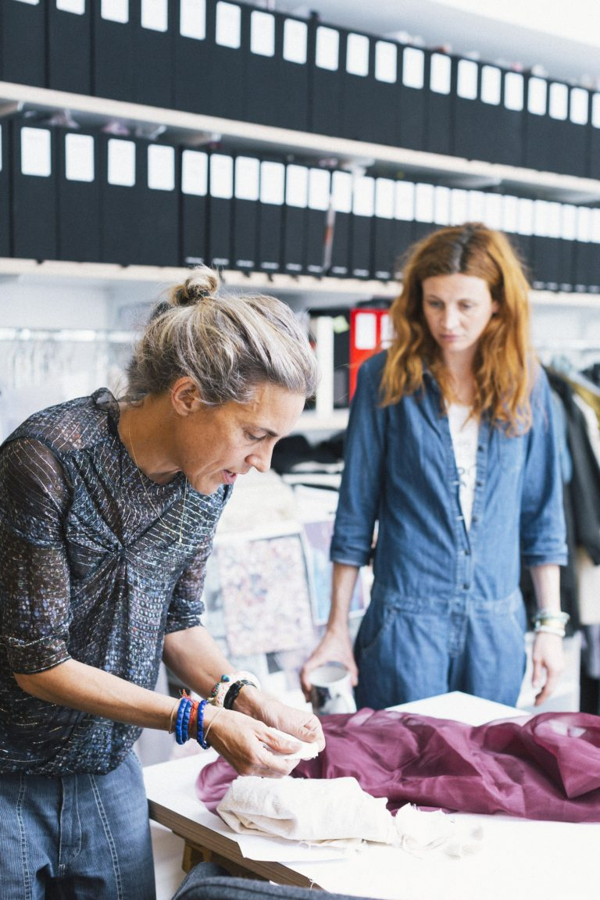
Preparing for your DPS journey : Cover letters
Cover letters often accompany your CV. They are what you use to demonstrate your suitability and pitch your interest to a specific role.
Your cover letter should be tailored to the specific role you are applying for. Directly respond to the requirements in the job specification.
Cover letters offer you not only an opportunity to demonstrate your knowledge of the company/brand but also to promote what you have to offer as a candidate.
Isabelle Marrant

Slide 28
Preparing for your DPS journey : Cover letters
The main difference between your speculative email and cover letter is that your cover letter is responding to a specific job ad.
Introduce yourself in the first paragraph and explain why you are applying for the role and why you want to work for the company.
Second paragraph is dedicated to demonstrating your suitability to the role. Think about the skills and experience mentioned in job ad and make references to them. Mention previous work experience as well as academic experience. Give a brief concise example of how you demonstrated this in the past and the outcome.
Summarise your suitability for the role, what you hope to gain for the future.
Be positive and confident in your writing and avoid negative statements! Show some personality in a professional way, and willingness to grow and develop in the role.
Your letter should be no longer than an A4 page. Half a page is better.
Remember even if your letter is actually an email it should still be formally written and structured.

Slide 29

Angel Chen for Canada Goose

Slide 30











Fashion job searching websites

Slide 31
Preparing for your DPS journey : Job searching strategies
ACTIVE JOB SEARCHING
PASSIVE JOB SEARCHING
Sign up and set up daily notifications for at least 6 different job searching websites.
Create a LinkedIn profile that is 100% complete and advising of your current status. (let people find you!!)
Set up daily notification for LinkedIn.
Follow, designers or creatives on social media. Be ready if they post an opportunity!
Check UAL creative opportunity website daily.
Check job opportunity emails from placement team daily.
Aim to make up to 7 applications a week.
Send speculative emails to companies/brands weekly.

Slide 32

Gucci SS16

Slide 33
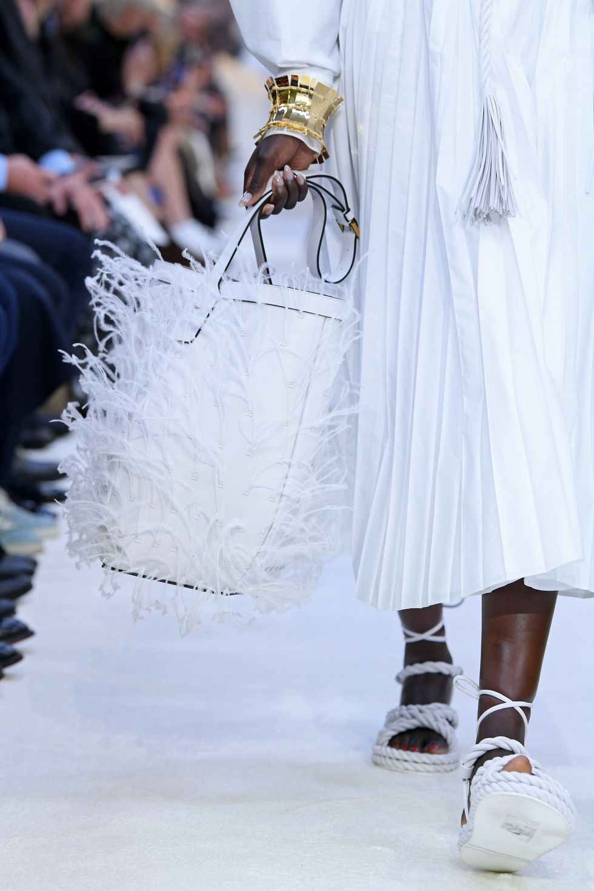
Preparing for your DPS journey : Portfolio’s
How do you feel about your year 1/2 project work?
Consider your portfolio as an “Ongoing project”.
What work can you use for your work-based portfolio?
Your portfolio is a piece of professional creative communication. Include work that looks professional and which the viewer will be able to understand. Think, structure, content & narrative.
The 3 most challenging aspects at this stage will be.
Feeling confident in your work.
Anticipating what the employer wants to see.
Learning to be very selective and editing your work.
Valentino 2020

Slide 34
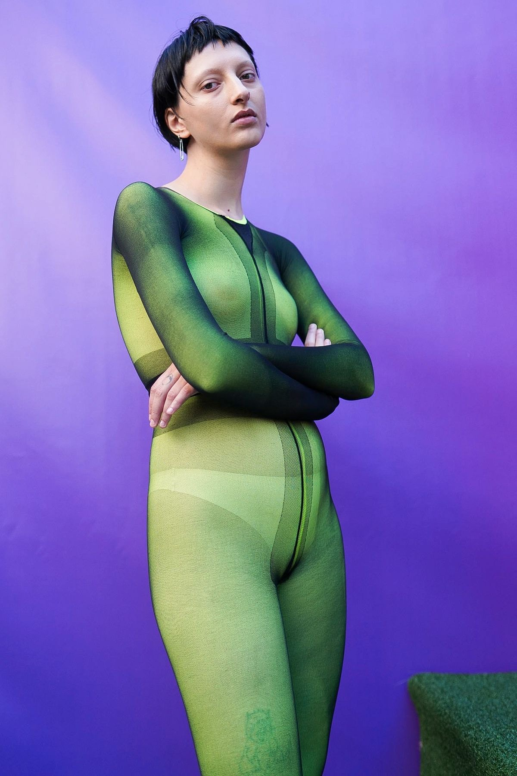
Preparing for your DPS journey : Portfolio’s
If you’re not satisfied with your year 1/2 work, over the Christmas break, go back to it and improve it! Be prepared to go over your work. Make good of the feedback you received from your tutors.
Your year 1 project work can account for 1/3 of your final portfolio edit.
Do not let your portfolio hold you back from applying for jobs when the time comes.
The project work you produce in your 2nd year should be good enough to go into your work-based portfolio. Start to produce work you are proud to share!
Ancuta Sarca

Slide 35
Preparing for your DPS journey : Design Portfolio’s
A well balanced, work based portfolio demonstrates a selection of key skills and creative talents can include the following. You may be asked create one of these elements for interview also:
Research (Concept & inspiration mood boards/ trends/ market level / customer profile/brand aesthetics)
Colour/fabric/materials/ trims/ hardware (Concept & inspiration mood boards/ trends)
Design development (Sketch books /design variations / 2D-3D/ toiling /sample & design process/ fit and function)
Final designs (CAD & illustration skills)
Line up and range plans (CAD skills /option planning /range building / look book /product photography)
Technical designs/specification sheets (CAD skills /technical communication /construction / production & manufacture)

Slide 36
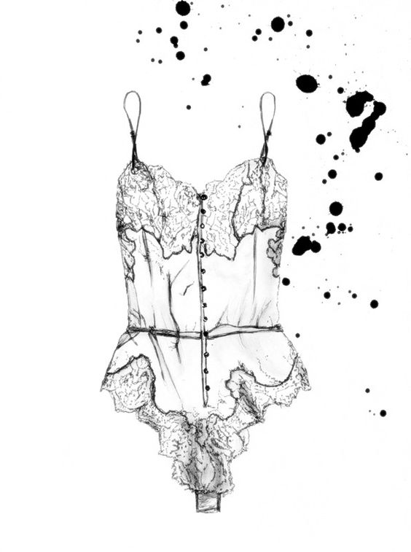
Preparing for your DPS journey : Portfolio’s Structures & Content
10 Page Portfolio:
Project 1
Page 1- Initial research (influences)
Page 2- Colour and fabric research
Page 3- Design development
Page 4- Final designs
Page 5- Look book images/ Finished garment
Page 6- Range plan/ technical sheet
Project 2
Page 7- Research
Page 8- Colour and fabric
Page 9- Design development
Page 10- Final designs
Portfolio edit:
3-page project
(consider a self initiated project that speaks for you as a designer or responding directly to a key trend, market level or brand aesthetic)…..
Page 1: Research/ colour/ fabric
Page 2: Design Development
Page 3: Final Designs/ Look book images
Example structure-Design pathway’s
Over Christmas start to create 3-4 page edits from course work & projects.
Show your creative process and a clear narrative
Notes:
I think you can show this as an example but not as a set format.
Everyone would have their own approach to prepare a portfolio but maybe you can share the key elements that needs to be included.

Slide 37
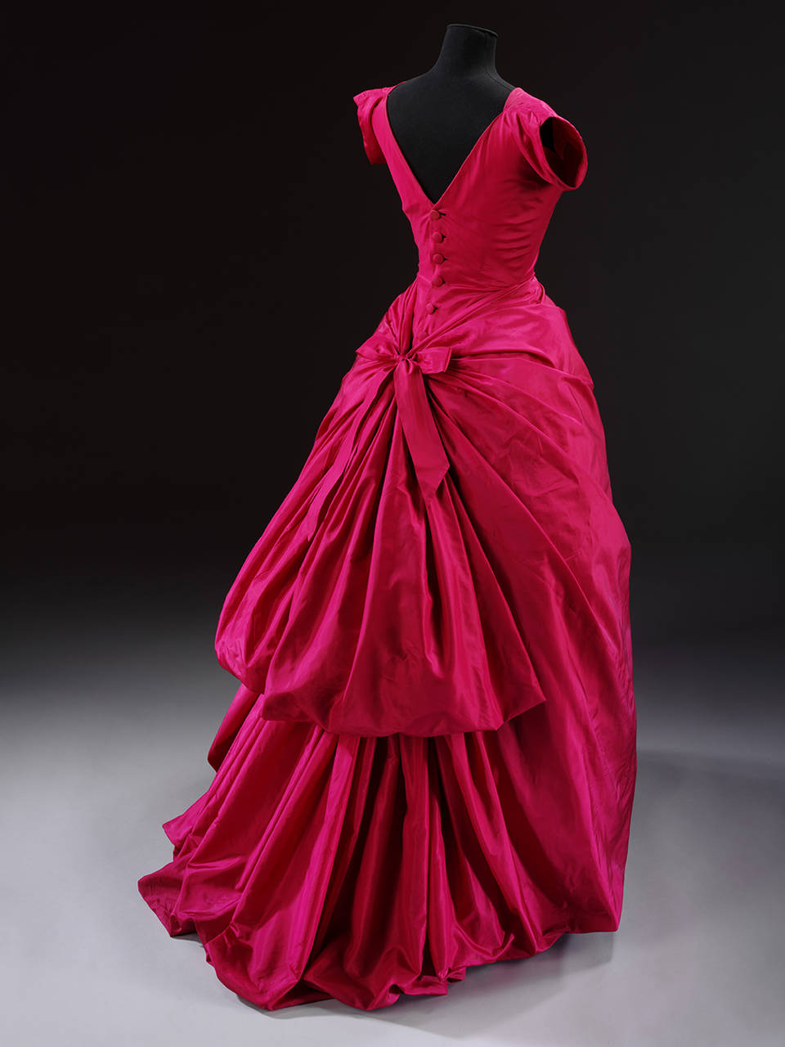
Preparing for your DPS: Portfolio’s
For Fashion Communication, Journalism and History and Theory pathways:
Create examples of your written work and research.
Show examples of your strongest pieces of writing and a range of work -Think interviews, Q&As, features, shorter pieces.
Including visuals can make a strong impact think- editorial layouts,
mood boards etc.
Fashion shoots, styling projects, film and video examples.
However a CV & cover letter may be all that is required.
Balenciaga @ V&A

Slide 38






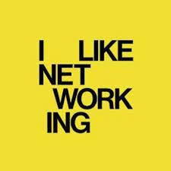

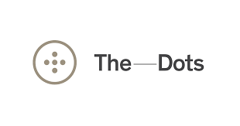

Preparing for your DPS journey : Portfolio platforms
Over the Christmas break start to look at examples of student, graduate and professional portfolios.
Get a sense on the common structure and content, format used and how to communicate your creativity in a profession way.

Slide 39
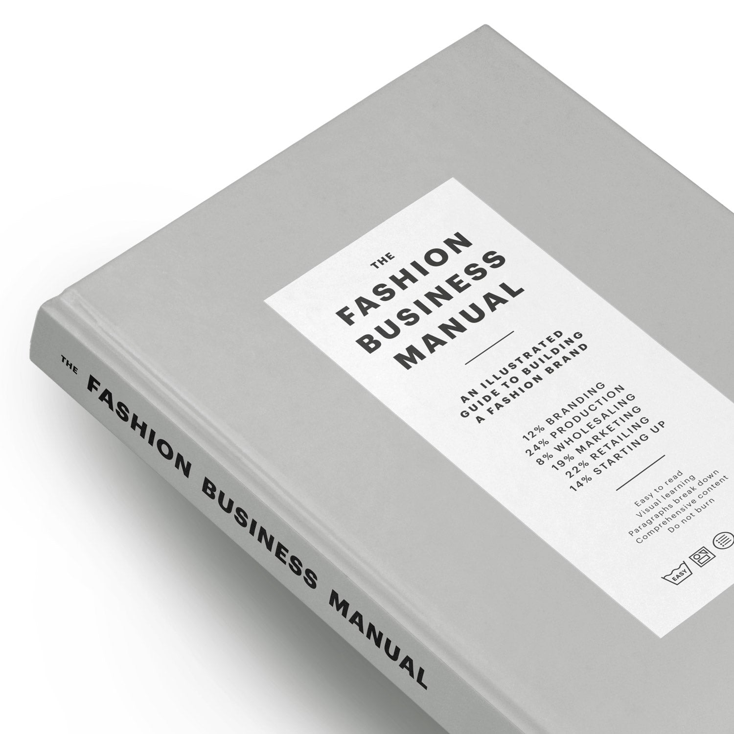


Slide 40
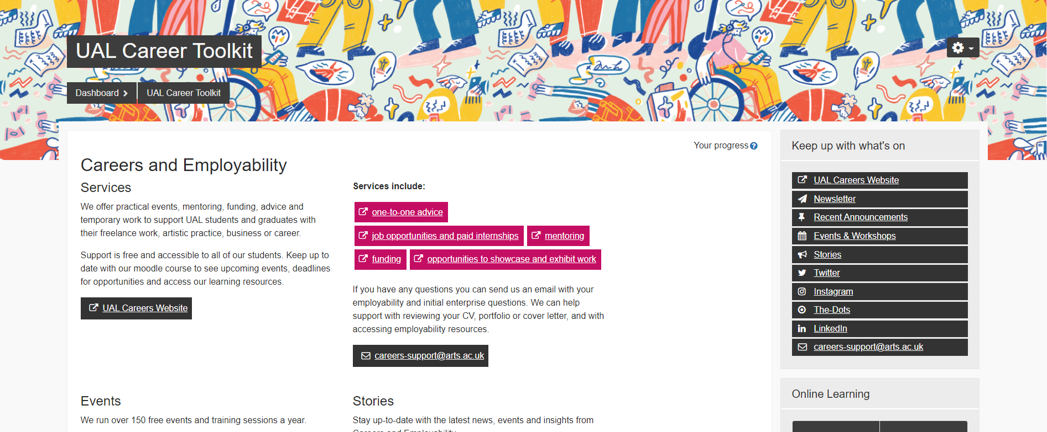
Preparing for your DPS journey : Making the most of UAL Career toolkit

Slide 41
Preparing for your DPS journey : Making the most of UAL Career toolkit
You have been auto enrolled for access to the UAL Careers toolkit.
This can be found on your Moodle page under “other courses”
Use this link to access https://moodle.arts.ac.uk/course/view.php?id=73517
The toolkit provides an abundance of careers support and advise and tools to help you assess your professional and personal skills and prepare you for the workplace.

Slide 42
Preparing for your DPS journey : Making the most of UAL Career toolkit
It includes tools to help with CV’s and cover letters, interview skills, portfolios.
Events & employability workshops and the 1-2-1 mentoring support and careers advice services provided.
Please visit this page and explore and familiarise yourself with the extra careers support that is provided by UAL.
We will share information on careers support and events happening in your DPS newsletter.

Slide 43

Preparing for your DPS journey : Making the most of UAL Career toolkit
Book a careers 1-2-1 20mins session
Career one-to-ones
We offer 20-minute career one-to-ones during term time, Mondays – Thursdays. You can chat to us about identifying your creative skills and career paths, where to find opportunities, preparing for interviews or for advice and guidance about your current creative career.
Book a one-to-one now.
https://www.arts.ac.uk/students/student-careers/career-resources
Career Wellbeing Wednesdays
We encourage students to view employability holistically. We empower you to understand what is important to you, and the opportunities open to you.
We offer Career Wellbeing one-to-one support to UAL students on Wednesdays from October 2022.
Book a one-to-one now.

Slide 44
Preparing for your DPS journey : RECAP
You will be required to “Opt-in” to do DPS. This deadline is Friday 26th January 2024.
To Opt-In you will be required to submit a “professional application package” which should include the following:
CV
Speculative email
Financial budget planner for placement year
Employability Skills Audit
For pathways that require a portfolio to apply for roles, you will work on your portfolio throughout the year and should use your pathway tutors to help you curate your best work that reflects your creative talents.
Job searching is a long process. It can take up to 3-4 months to find and secure your placement.
You should be ready to send your speculative emails out and respond to job opportunities posted as early as March 2024.
Some large businesses/brands (with paid opportunities) will advertise and try to secure placement students early in the year.

Slide 45
DPS Year 2 preparation Timelines
January 2024
1. DPS Opt-in deadline: Submission of professional application package
May 2024
1. DPS -1-2-1 tutorials
2. DPS Online drop-in surgeries Tier 4/funding/visa
October: Intro to DPS Briefing
December 2023
DPS online drop-in session: Questions & Advice about DPS
March 2024
1-2-1 tutorials
SFE/Funding & Finance briefing
End July 24 Deadline to secure placement TBC
START JOB SEARCHING!
November 2023
DPS Key Guidance funding & finance session
Final years DPS feedback session
How to prepare for your DPS journey Part I &II Preparing your Professional application package
June 2024
1.DPS 1-2-1 tutorials
2. Final DPS briefing
April 2024
DPS -1-2-1 tutorials
DPS Online drop-in surgeries Tier 4/funding/visa
February 2024
1-2-1 Tutorials

Slide 46
Preparing for your DPS journey : OPT-IN DROP-IN
We will hold an online Drop-in session on Wednesday 6th December 1pm-2pm
Please come online to ask any questions you may have about doing DPS and the Opt-in requirements.
Link will be shared via email

Slide 47


Slide 48
Thank you
DPS Coordinators & Placement Tutors:
Wande Awoniyi
w.awoniyi@csm.arts.ac.uk
Maria Nishio
m.nishio@csm.arts.ac.uk

